Slide 1





cordap.org
Coral Accelerator Program
Full Proposal Deadline February 22, 2024 (5:00 PM UTC)

Slide 2
Welcome to Full Proposal Webinar
This webinar will be recorded and a link placed on the website at https://cordap.org/full-proposal-docs-cap2023/
Please submit questions through chat – We will go through the questions at the end of the slides.
If we do not get to all questions today, we will update the FAQ with the outstanding queries
For questions relating specifically to your review feedback, please email funding@cordap.org
Full Proposal Documents available at https://cordap.org/full-proposal-docs-cap2023/
Can send any further queries to funding@cordap.org

Slide 3
CORDAP Coral Accelerator Program – Concept Notes
Number of Proposals Received 120
Total number of applicant ( Inc. co-apps) 605
Total number of countries involved 80
Total Number of LMIC Countries 45
Proposals Led by LMIC Countries 40
Number of Female Lead Applicants 38
Number of Female applicants in total 234
Total funding requested over US $159 million
39 Proposals have been invited to Submit a Full Proposal
Maximum budget of US $18M, approximately 12-13 proposals can be funded

Slide 4


CORDAP Funding Policies
Intellectual Property
  CORDAP does not seek to own any of the IP resulting from its funded activities. Ownership vests as agreed by the organizations collaborating on the research.
  Owners of IP resulting from CORDAP-funded activities must provide a free license for all commercial and non-commercial coral restoration use, including free license to any background IP the project relies on.
  CORDAP-funded developments and technologies should be made available and accessible at an affordable price to all coral restoration projects.
Open Access
  Publications, and underlying data, will be immediately, freely and openly accessible to all
  There should be no barriers to the re-use and dissemination of CORDAP funded publications
  CORDAP will pay necessary reasonable fees.
  Research data and software should be Findable, Accessible, Interoperable & Reusable (FAIR).

Slide 5

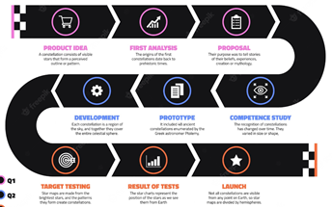
CORDAP’s Coral Accelerator Program (CAP) 2023
Objectives and Goals
CORDAP will deliver technologies, methods, and processes that can be applied in conservation and restoration efforts across the world through existing national and international efforts.
Innovation crucial to filling the significant gap between current and required global capabilities.
Projects funded under this program are expected to lead to significant discoveries, innovations and improvements over the current state of the art.
Proposals transcending different disciplines and fields, and including end users in the research, design, and development of projects are strongly encouraged - identify suitable partners and groups that can further develop and deploy the proposed technologies.

Slide 6
How is the Full Proposal different from the Concept Note?
A Concept Note, or pre-proposal, is a shorter statement of your project objectives, methodology, intended users and estimated budget.
The Full Proposal is a more detailed, final version, incorporating concept note panel feedback and including formal organization sign off on all aspects of the proposal and agreement to CORDAP policies.
Full Proposal Sections:
The Project Narrative : ( 8 pages maximum)
Background and Motivation
Aims and Objectives
Strategy and Work plan
Impact, Knowledge Transfer, and Success
Intellectual Property
Things to look out for:
Ensure you cover the current state of the art and developments in the field.
Make sure you cover all risks, and potential mitigation actions, in particular early risks in a project.
Full engagement of LMIC partners and regions

Slide 7
How is the Full Proposal different from the Concept Note?
Full Proposal Sections:
The Project Narrative
Project Management Plan – (3 pages)
Overall Project Management and collaboration plan
Risk Assessment and Management
Summary of Key Deliverables
Gantt Chart
An Intervention Concept Summary is required for project types: ( additional 2 pages maximum)
• Novel R&D projects,
• Improving or scaling up existing interventions, or
• Translation R&D
Budget Information required for all proposals

Slide 8
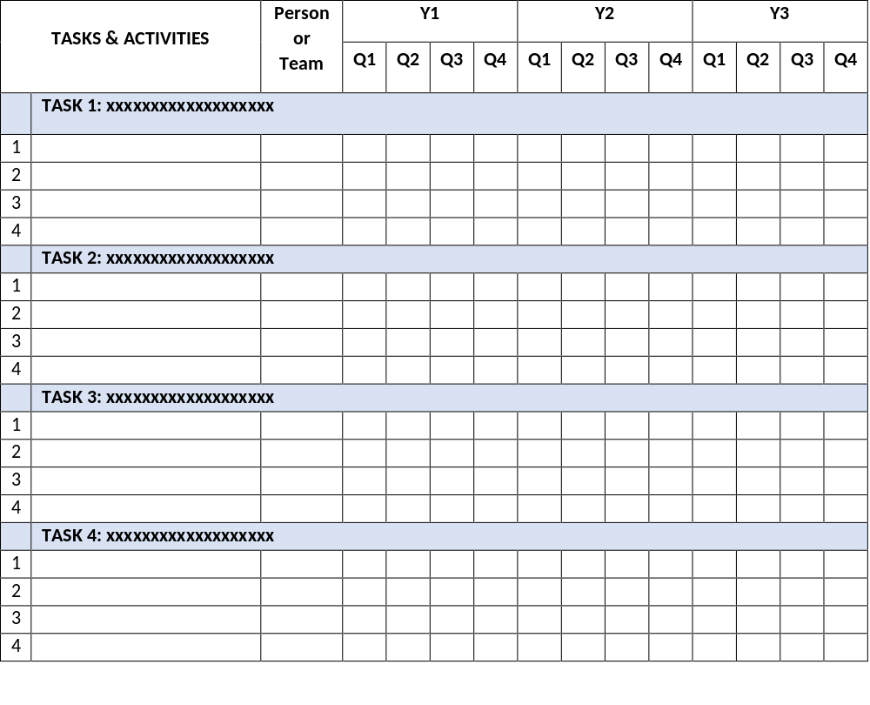
How is the Full Proposal different from the Concept Note?
Gantt Chart
Add/remove number of tasks as needed. Indicate person(s) or team(s) responsible for the task.

Slide 9
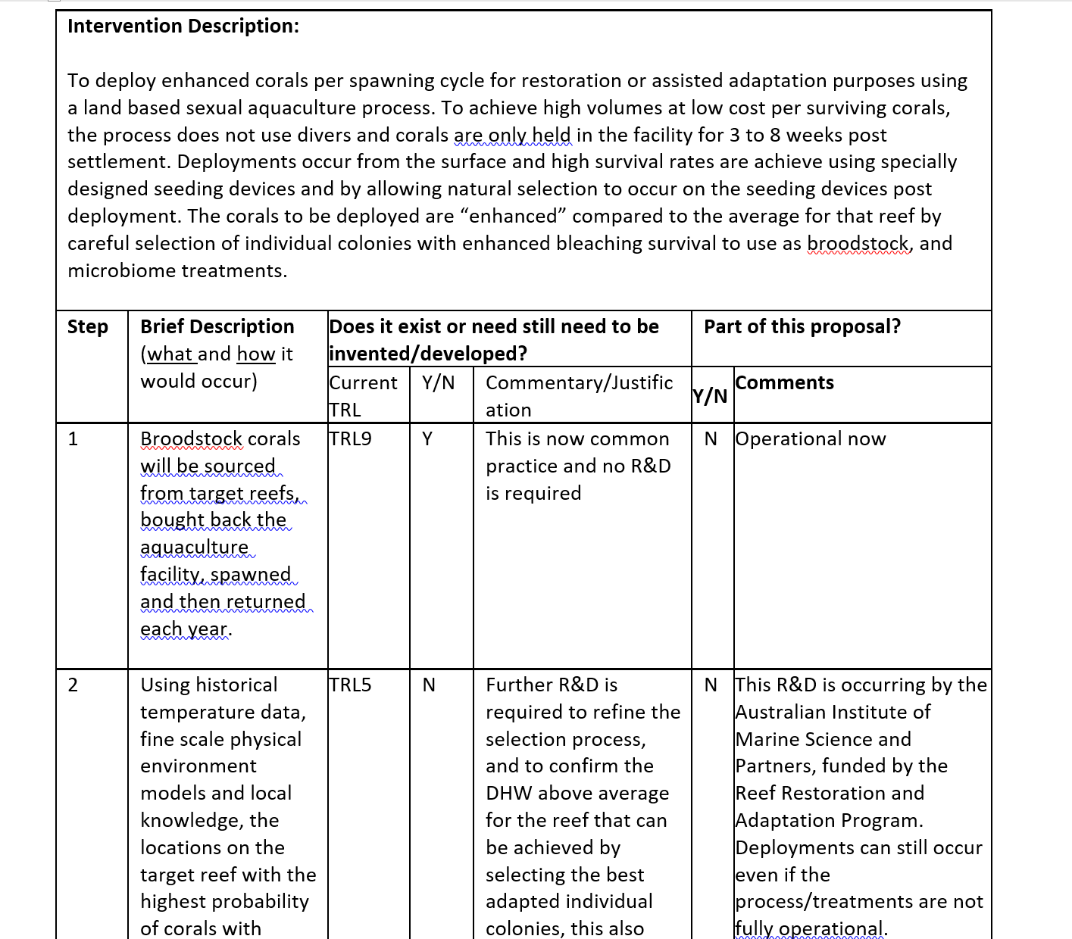
What is an Intervention Concept Summary
Example Case
Provide visibility as to what additional aspects, technologies or methods will need further development before the proposed project can have full impact.
Make it clear which steps this R&D project relates to as opposed to ones which are necessary for the intervention but are being addressed in other institutions/projects.
Do the other required ‘bits’ for your idea to work exist now?
TRL level not required but useful information to include

Slide 10
CAP – Proposal Budget
Budgets must be prepared using the supplied budget template. ( Excel uploads, with summary form fill information)
Requested costs must be related to research and integrated educational activities directly related to the project. There is a budget guidance sheet in the excel file.
Equipment: It is expected that participating organizations will already be equipped to pursue their current research. Purchase of equipment essential for the project which is proposed is eligible. (renting encouraged where cost effective )
  Capital Equipment (assets/equipment over US$5K):
    The proposed maximum allowable cost for any single unit of equipment is US$80,000.
    Sharing/Asset Ownership/plans after the award for large equipment requests.
Note: The type of equipment/materials requested, and its use, will be taken into account and viewed differently, for example laboratory equipment used to aid research vs equipment and materials used to build prototypes.
NOTE: Budgets may be adjusted between Concept Note and Full Proposal stage, in particular if based on feedback from the Review Panel.
Cost Share: Leveraging CORDAP funding with Cash and/or In-Kind contributions to the project are very much encouraged but not mandatory. Dedicated section for outlining cost share will be included in application, in-kind contributions will not be financially quantified. Contributions to the project will be taken into account during proposal review.

Slide 11
CAP – Proposal Budget Justification
Budget & Justification
  Add budget detail online, plus the budget justification
  Upload Completed Excel File
  Justification: Explain why items are essential in relation to the aims and methodology of the project as well as meeting the goals of the project. You should not merely restate the proposed expenditure.
  Detail provided should be commensurate to the amount of the requested line item.
  You are trying to demonstrate to reviewers that your costs are reasonable, necessary, in line with your activities and provide good value for the funding requested.
  A greater breakdown of costs is required at the Full Proposal stage.
  Breakdown travel costs, differentiate between travel costs for meetings/conferences etc, and field work.
New Section in excel file – Budget broken down by task – please estimate this as closely as possible given that resources may be shared between tasks

Slide 12
CAP – Reporting and Payment Schedule
It is recognized that many organizations, particularly in developing countries, may not have the resources to undertake much of the project costs in advance. This is reflected in the payment made upon signing the award contract
Payments are lump sum payments annually upon receipt of an annual report.
Any unspent funds must be returned to CORDAP at the end of the project.
Brief Interim updates/ highlights required , traffic light, highlights, successes - this information critical in the platform resourcing loop. ( quarterly/6 monthly).
 | Reporting deliverable | 1 Year Project | Up to 2 years | Up to 3 years
Upon Contract Signing |  | 50% of Project total | 40% of Project total | 30% of Project total
End of Year 1 | Progress/Final Report Financial Report | Financial Reconciliation – Payment of remainder of project funds spent. | 40% of Project Total | 30% of Project Total
End of Year 2 | Progress/Final Report Financial Report | NA | Financial Reconciliation – Payment of remainder of project funds spent. | 30% of project Total
End of Year 3 | Final Report Financial Report | NA | NA | Financial Reconciliation – Payment of remainder of project funds spent.

Slide 13

Consortium Agreement - NOTE: Not required at this stage – information for your organization
CORDAP makes the Award to the Lead Institution only.
Successful applicant organizations are required to sign a legally binding Consortium Agreement ( among themselves) before funds are disbursed.
The consortium agreement sets the framework for a successful project implementation and is a private agreement between the participants to set out the rights and obligations amongst themselves. (It does NOT involve CORDAP itself.)
The Consortium Agreement details:
Project implementation and division of tasks, internal organization and management of the consortium.
Project budget and distribution of funding,
Rules on rights and obligations related to background and results, and liability. In addition,
IP management, exploitation and dissemination of results, boilerplate provisions: duration, termination, communication, applicable law and settlement of internal disputes etc. must be addressed in the agreement.
A CORDAP template Consortium Agreement for applicants to modify for their team is available.

Slide 14
Proposal Evaluation Criteria and Process
Full proposals will undergo a full international 2 stage peer review ( topic experts evaluation feeding into Panel review).
All eligible applications will receive feedback from the Review panel, whether invited to Full Proposal or not.
The Review Criteria remains the same as the Concept note stage.
All proposals will be evaluated against the criteria below:
Qualifications and track record of the Applicant teams and applicant diversity
Innovation or novelty of the idea
Potential of the project to make step changes, be transformational in its field.
Targeted impact and pathway and timing to impact
Alignment with nominated R&D investment themes or areas
Management and coordination of the project
Cost-effectiveness of the proposed project
Broader impact and breadth of socioeconomic applicability
CORDAP will seek to fund a balanced and complementary portfolio of projects across the project type and priority areas to ensure a broad impact.

Slide 15
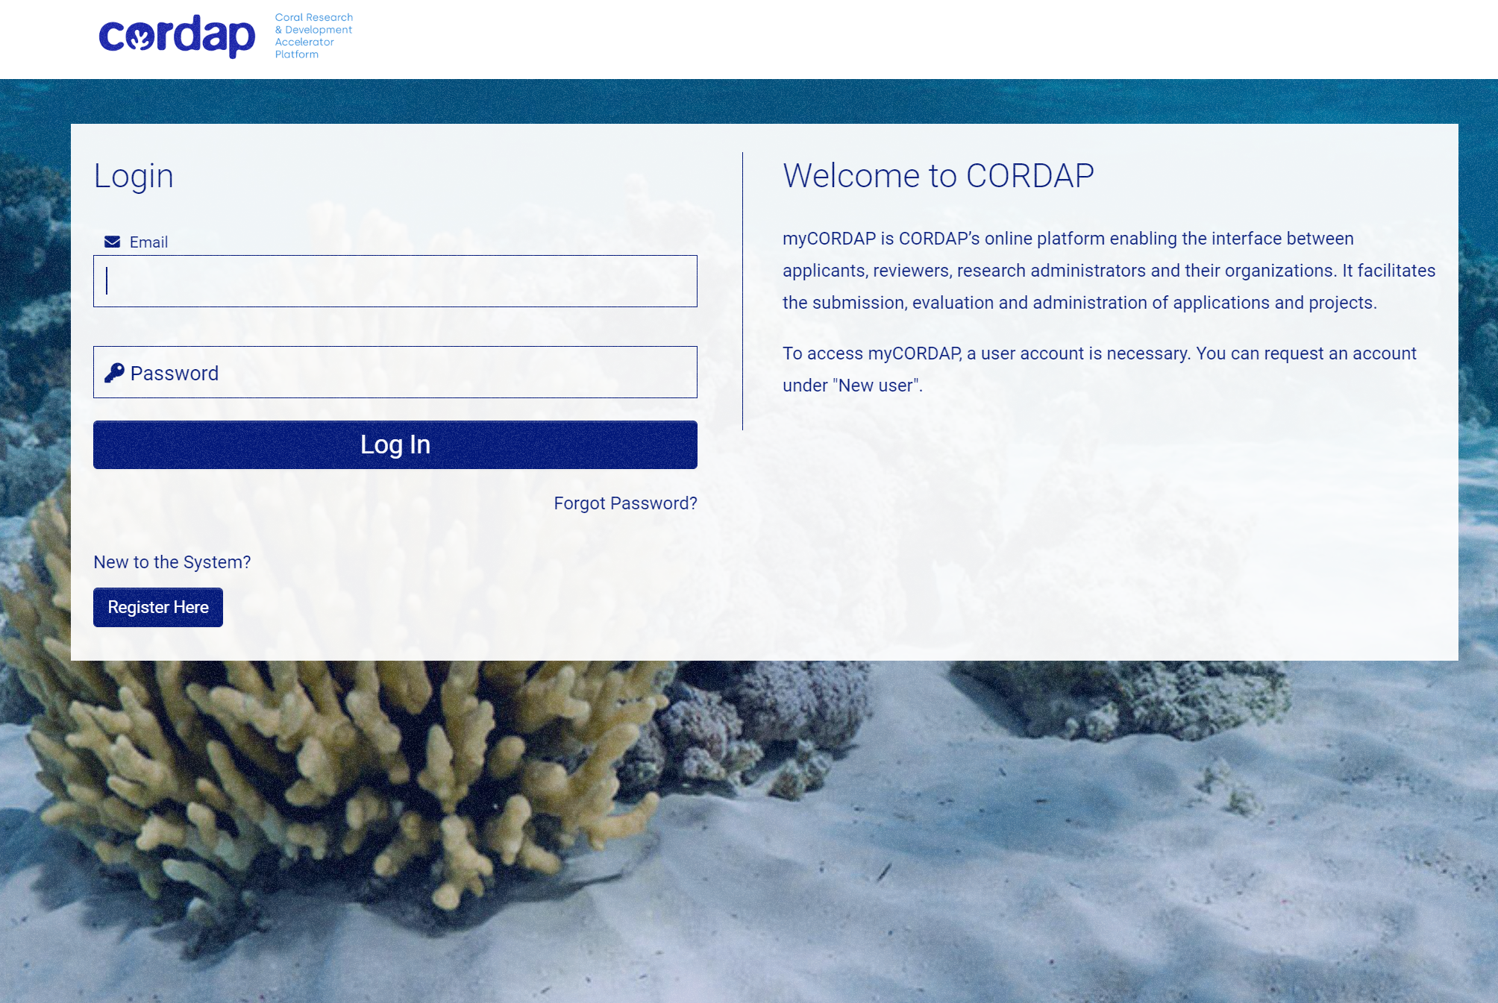
How do I submit a Full Proposal?
All applications are made through our online submission system – myCORDAP
Only the Lead Applicant needs to register and complete the submission.
There is a submission help document on the website (Submission Assistance ) which will guide you through each stage of registration and submission.
At Full Proposal Stage, there are three documents you need to complete and upload
  Full Proposal Submission Form Template
  Full Proposal Budget Template
  Combined Statement of Intent forms
  Optional ( Letters of Support)
  The rest of the information you filled in for the Concept note will be pre-populated for you to edit.
  You can save a draft application, leave and return to complete at any time, ‘validate’ will check you have completed the required sections, and you can delete an application and start a new one.

Slide 16
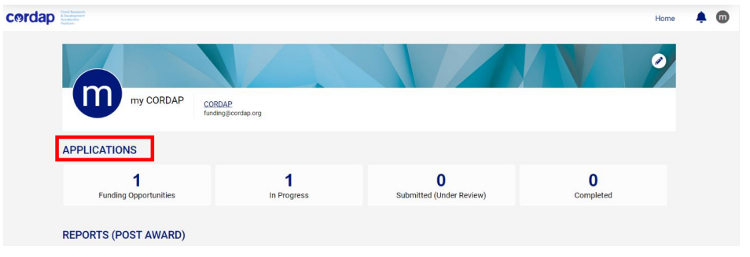
Online Submission of a Full Proposal
Once you have registered, you will be directed to your applicant dashboard:
The Full Proposal will be available in the ‘In Progress’ tab.

Slide 17
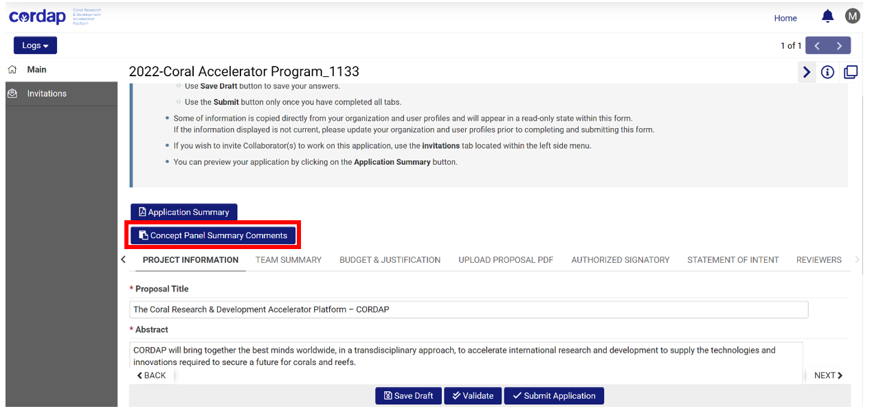
Online Submission of a proposal
You can view the Feedback of the Concept Note Review Panel by clicking on the Tab ‘Concept Panel Summary Comments’
The ‘Invitation’ is a feature that allows the Lead Applicant to invite and give Co-Applicants access to their Full Proposal draft submission system to edit and complete sections but they do not have the ability to ‘Submit’ the proposal.
You can add up to three suggested reviewers who have relevant expertise in the proposed research to review your application. You can also add names of restricted reviewers whom you wish we should not contact for the review of your proposal. We will not approach these individuals.

Slide 18
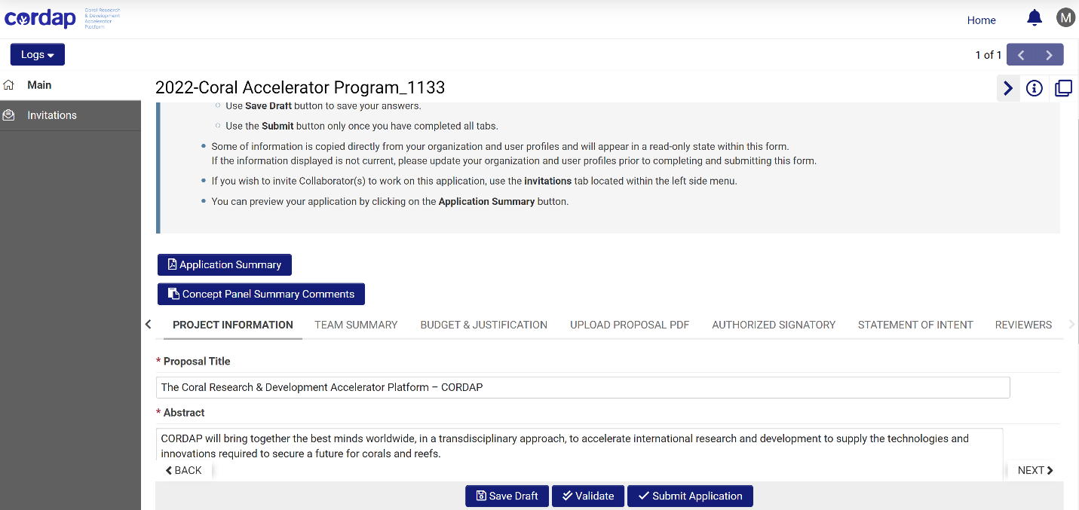
Online Submission of a proposal

Slide 19
Some important points to note
Innovative with high potential for impact or transformative advances – is it transferable? The responsibility is on the applicants to build this in, not just ‘ others can/may/will use it’…
The solution is broadly applicable – not specific to your location or circumstances
Demonstrated knowledge of the field – state of the art and existing solutions - why is your idea better?
All the required expertize is covered – all team members are required, integrated into the plan and have input to the proposal, and the budget reflects this – in particular developing country team members.
Clearly states the problem, solution, approach, objectives and work plan ( if multiple parts, bring ideas together to form a single coherent proposal)
For translational/development projects – know what else is needed!
Clearly state the IP position where required.
Good management of the project – address the risks, both technical and operational!
Where relevant, discuss potential long terms plans for your solutions.

Slide 20
THANK YOU
Questions Welcome

